Slide 1
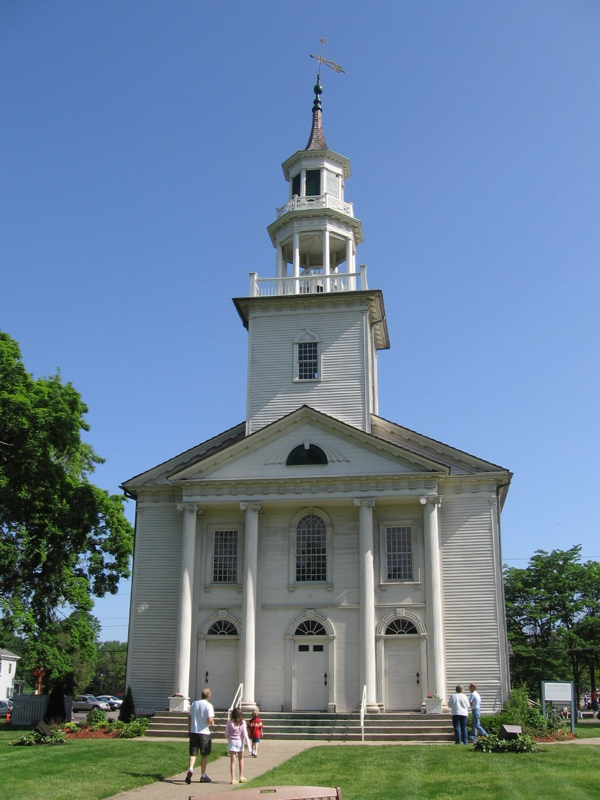
The Battle of Neighborhoods
Tallmadge, Ohio USA

Slide 2
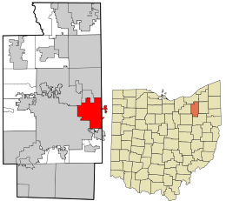
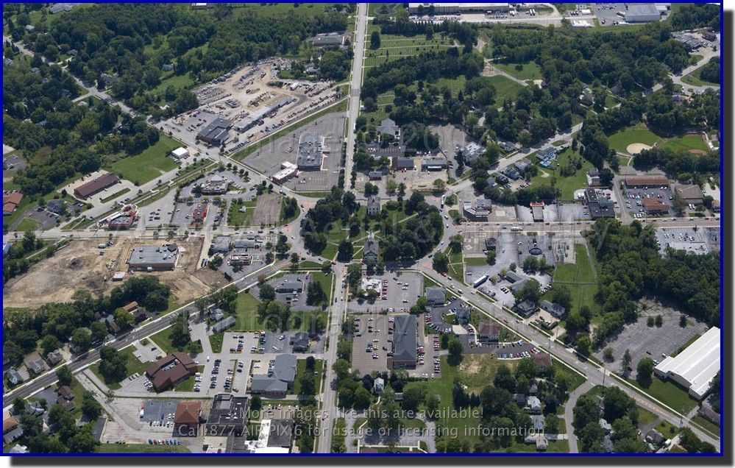
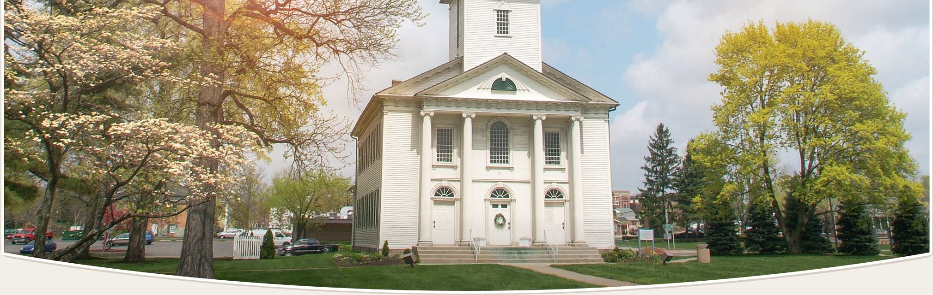
Tallmadge, Ohio USA
Suburb of Akron, Ohio
Center of Town is Tallmadge Circle Park or “the circle”.
Inside the center is Historic Tallmadge Church built in 1825.
Most businesses in town are located around the circle.

Slide 3

Data Science Problem
Can data science help us help in setting up a business in this area?
Would like to know the different types of restaurants in Tallmadge.
It would be beneficial to see where some of the restaurants are located.

Slide 4

Stakeholders
Potential business owner
Local government
Customers interested in a new restaurant

Slide 5

Process and tools
FourSquare Location
Tools
Geopy
Pandas
Matplotlib
Folium
Excel

Slide 6
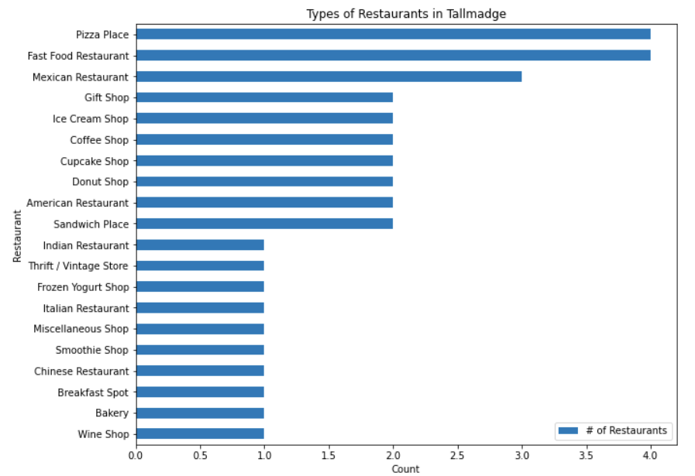
Analysis
4 different Pizza places and 4 Fast Food Restaurants
Lots of 1 category restaurants
Wineshop is an outlier
Showing up with a wrong address in Tallmadge but in Kent, Ohio.
Opportunity

Slide 7
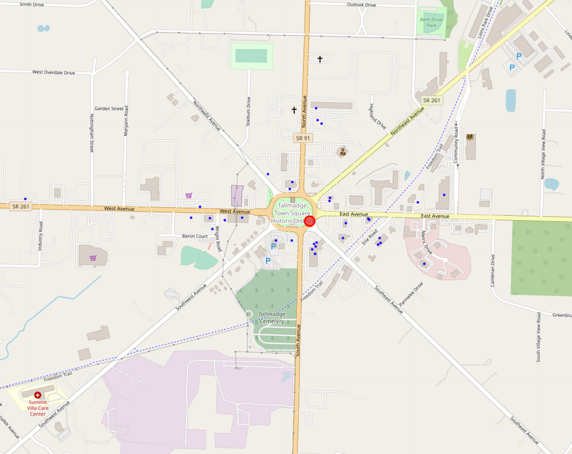
Analysis
Map of Tallmadge Ohio in Folium
Backs up claim that most restaurants are located around the circle.
Interesting to see some are more clustered than others.

Slide 8
Analysis
Looked at location of restaurants in relation to street roads.
Not a lot of restaurants located in between Southwest and South Ave but also Northwest and West Ave
Opportunity

Slide 9
Further Analysis
Some restaurants had incorrect location data or no address at all.
FourSquare is probably more accurate with larger cities.
Restaurants that have been closed down for years showed up in the map and lists.
Actual market research needed to survey Tallmadge customers to see if they want a certain type of restaurant in town.

Slide 10

Conclusion
Data science can help us with opening up a restaurant!
The data provided shows that we should consider opening up a Wine shop between Southwest and South Ave but also Northwest and West Ave.
Combination of Wine and bakery could be very profitable!
Further market analysis needed.

